Slide 1
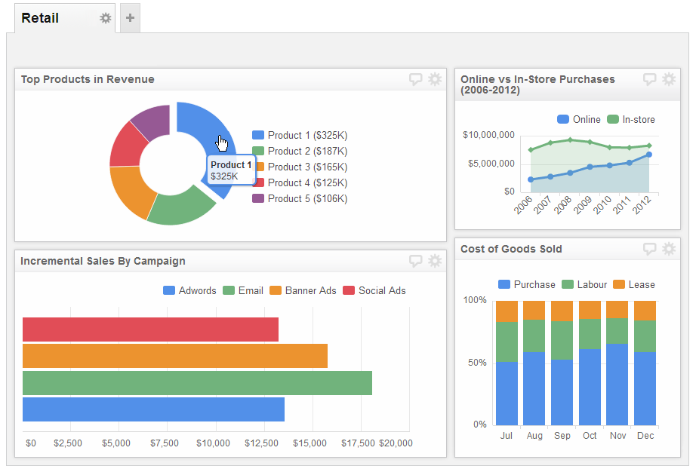
Understanding BI Reports and Dashboards
Topic 04

Slide 2
Contents
BI enables BPM
Business Reporting

Slide 3

Introduction
Introduction to BPM
To stay competitive, companies need to run their business with maximum efficiency and effectiveness
To achieve maximum performance, companies need to know which of their business processes are run efficiently and effectively, and which are not

Slide 4
The Corporate Challenge
Introduction to BPM
Business processes are the foundation of a business’s products, services and brands
Business processes include
Distribution of goods, Collaboration with suppliers, Co-ordination of the efforts of employees etc
Successful companies are often those with the most effective and efficient business processes

Slide 5
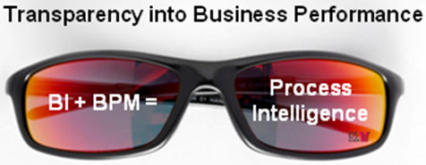
How BI enables BPM
Introduction to BPM
To attain efficiency, control, response with improvement, companies must understand their processes, the needs and skills of the people who use them, the changes that affect them and which areas need improvement
To understand these things, they need relevant information and the ability to analyse and apply it
Business intelligence (BI) tools are able to generate business reports that provide this information
BI when linked with BPM, gives people the input they require to improve business processes

Slide 7
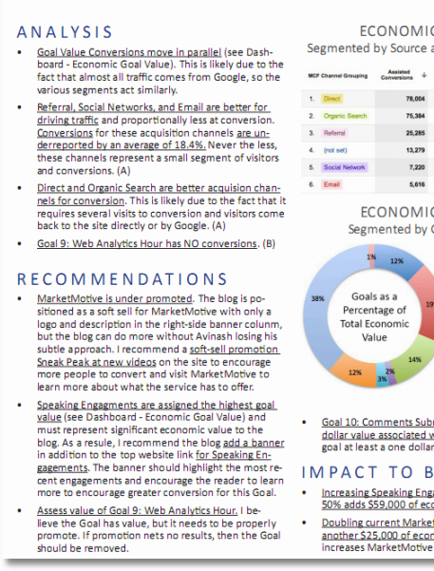
Functions of Business Reporting
Business Reporting
Decision makers need information to make accurate and timely decisions
Information is often provided in the form of reports
Reports can help management to :
track that all departments are functioning
provide the results of an analysis
persuade others to act
create an organizational memory for others to learn from

Slide 8
Types of reports
Types of Enterprise Reports
BI systems are able to generate a wide variety of enterprise reports for different purposes
Enterprise reports typically fall into 3 categories
Tactical Reports
Strategic Reports
Operational Reports

Slide 9
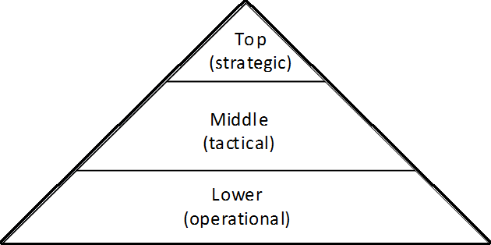
Reports for different management levels
Types of Enterprise Reports
These reports are aligned to help the management at different hierarchical levels to decisions at the operational, tactical and strategic level
Identify new markets, choose store locations
Choose suppliers, forecast sales
Resolve order delays, schedule employees
Decision making hierarchy
Typical decisions

Slide 10
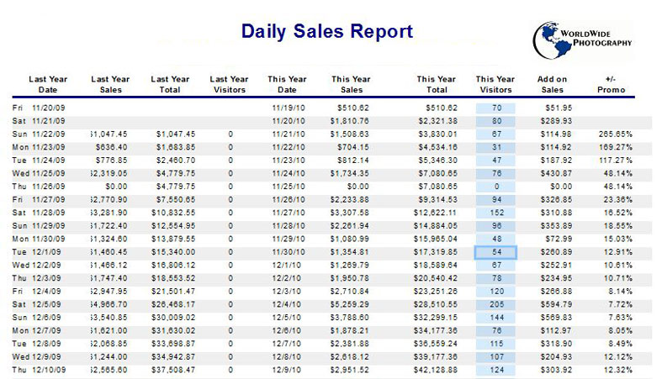
Operational Reports
Types of Enterprise Reports
Operational reports are typically generated at fixed intervals
E.g. Daily Inventory Report, Monthly Sales Report etc
Usually very detailed and delivered as spreadsheets

Slide 11
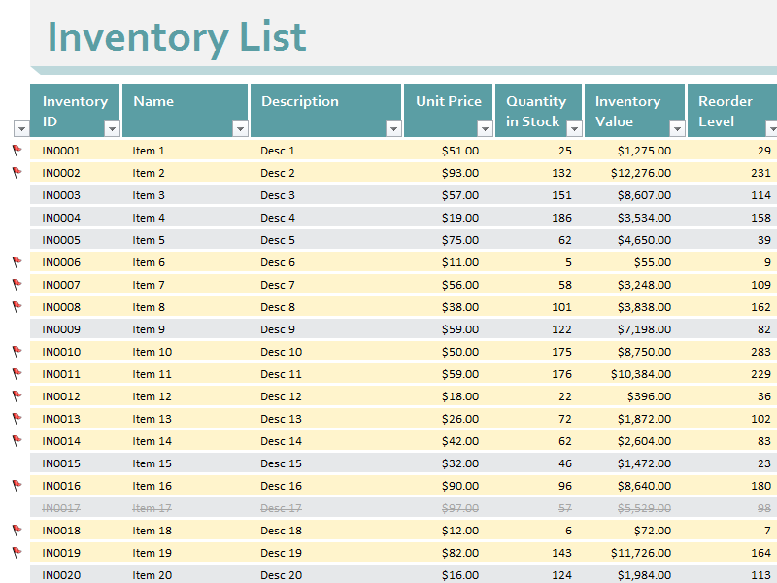
Operational Reports
Types of Enterprise Reports
Typically consumed by lower management to help them make decisions at an operational level
E.g. Store manager reviews inventory report to see if he needs to restock an out-of-stock item

Slide 12
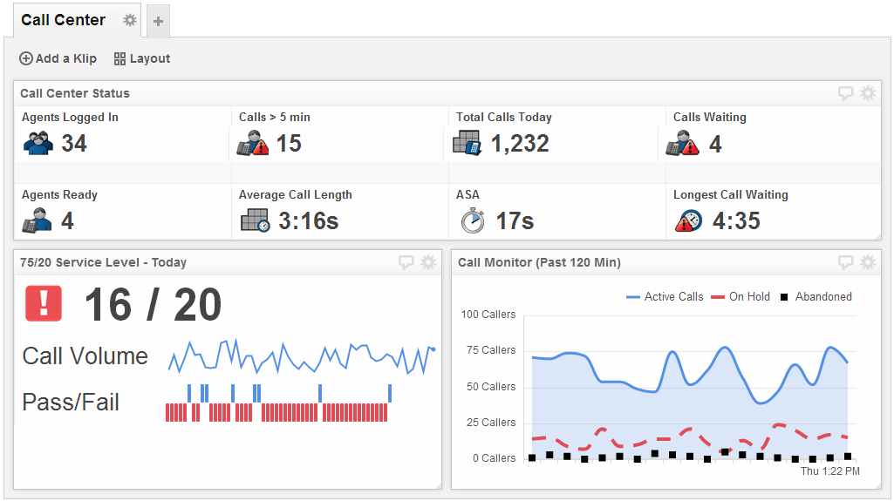
Operational Reports
Types of Enterprise Reports
Besides spreadsheets, operational reports can also be delivered via Operational Dashboards
Operational dashboards display frequently changing and current key performance metrics (KPI)
They are often focused on exception alerting, based on real-time or transactional data
The diagram shows a real-time operational dashboard that tracks the performance of a call centre

Slide 13
Tactical Reports
Types of Enterprise Reports
Tactical reports are reports that are less detailed
They are summarised reports which require analysis via technologies such as OLAP
Typically consumed by the middle management for short-term tactical planning

Slide 14
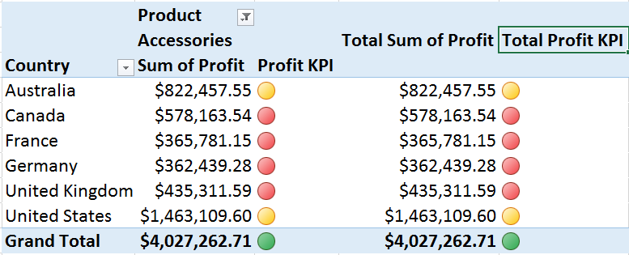
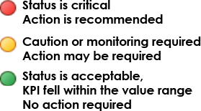
Tactical Reports
Business Reporting
Tactical reports may present
Analysis of business trends e.g. compare sales this year to sales last year
Summary of the KPI (Key Performance Indicator) performance in a certain area

Slide 15
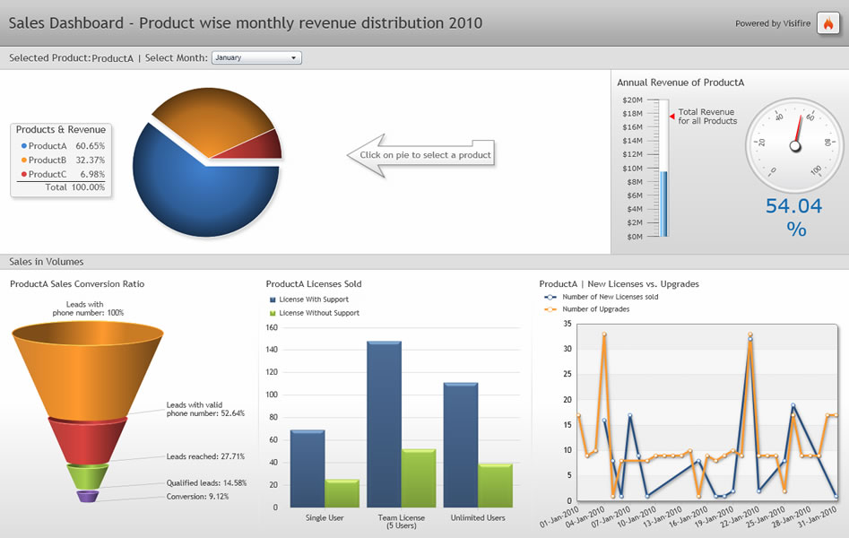
Tactical Reports
Types of Enterprise Reports
Tactical reports are often presented as dashboards which summarise important KPIs on one page
Typically, dashboard vendors would provide a set of customizable widgets that allow users to present performance indicators in a visually presentable way

Slide 16
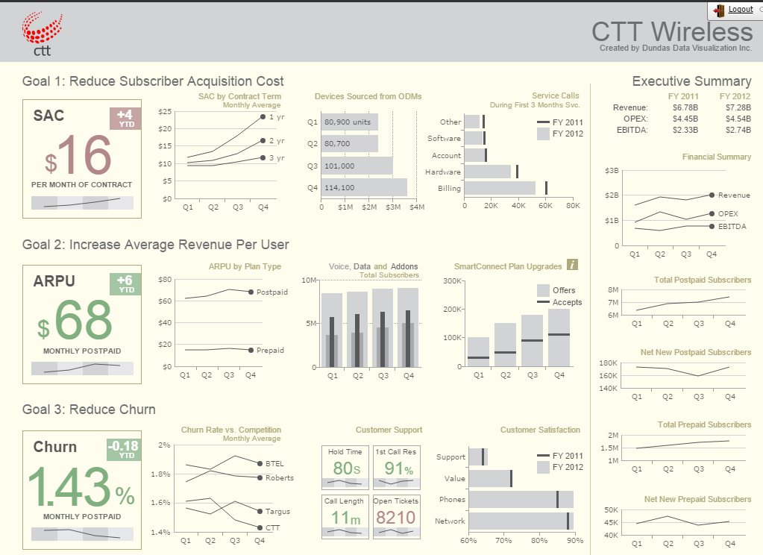
Strategic Reports
Types of Enterprise Reports
Strategic reports are the most summarised of the three
Consumed by the top management for long-term strategic planning

Slide 17
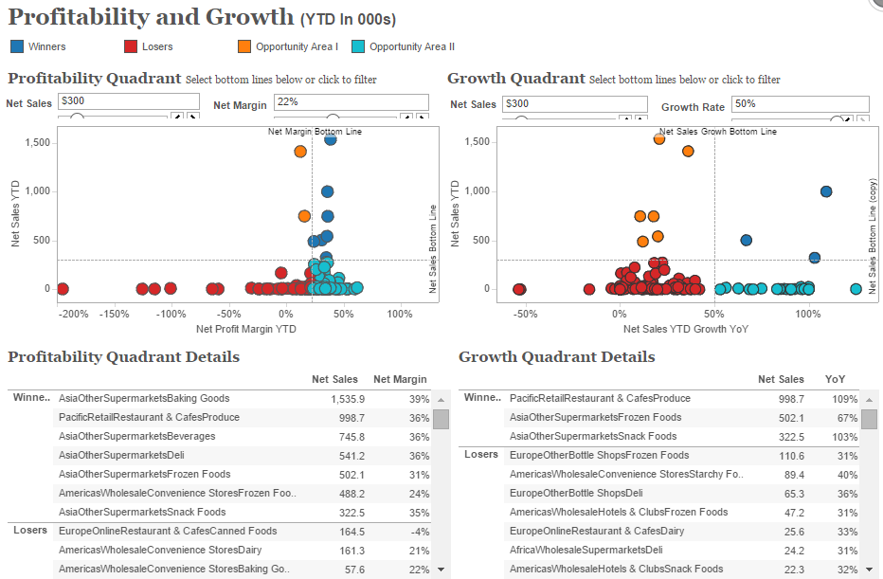
Strategic Reports
Types of Enterprise Reports
Strategic Reports are meant for the top executives to visualize aspects of the business environment at a glance
Often include data pulled in from external sources, e.g. world population data
Typically include recommendations by the middle management based on their own analysis of the tactical reports

Slide 18
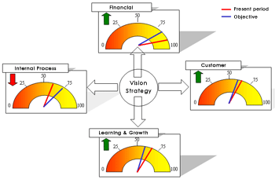
Strategic Reports
Types of Enterprise Reports
The Balanced Scorecard (BSC) is a method developed by Kaplan and Norton that attempts to present an integrated view of success in an organization
In additional to financial performance, balanced score-card type reports also include information on customers, business processes and learning & growth
BSC reports a form of strategic report

Slide 19
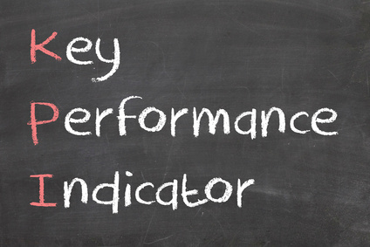
Key Performance Indicators (KPIs)
Performance Measurement
Companies set Key Performance Indicators (KPIs) to measure how their businesses are performing compared to their strategic goals and objectives
KPIs help companies to understand if they are on track or they are off target
This enables them to make decisions on what they need to do so that they are able to achieve their goals and objectives

Slide 20
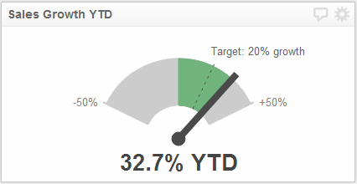
KPIs that companies can measure
Performance Reporting
If a company's goal is to make more money, it might want to measure KPIs such as sales growth, profit margins and operating costs
If a company wants to attract new customers by creating a great brand, it might measure KPIs such as brand equity and brand awareness
If a company wants to ensure its customer service is on par, it might want to measure customer feedback as a KPI

Slide 21
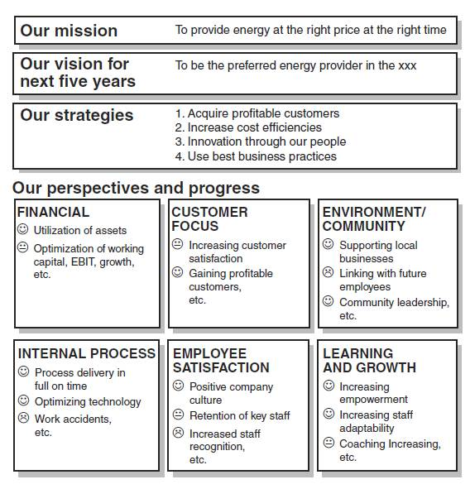
KPI reporting
Performance Reporting
Key performance indicators (KPIs) can be reported to management yearly, monthly, weekly, daily
KPIs can be conveyed in multiple ways, through an Excel spreadsheet with tables, a Microsoft Word document with some key figures and charts etc
The most common way KPIs are reported nowadays is via PERFORMANCE DASHBOARDS

Slide 22
Types of Performance Dashboards
Performance Dashboards
Just like
Strategic
Tactical
Operational

Slide 23
Strategic Dashboards
Strategic dashboards are used by the top management of a company
The KPIs displayed

